Slide 1
    Geology for Engineers
    (WED. 1:00pm - 4: 00pm)
    Part 2
^{1st} Sem. SY 2025 - 2026
Aug. 6, 2025

Slide 2
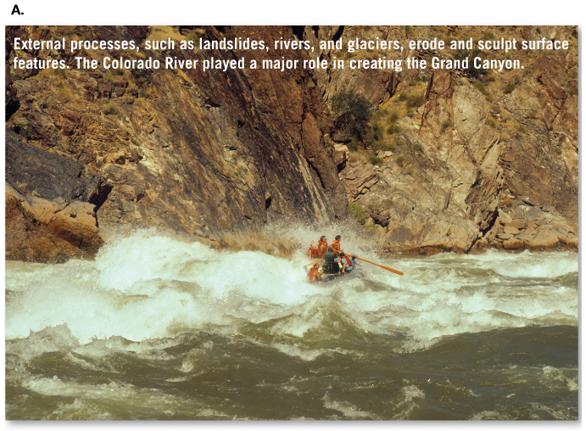
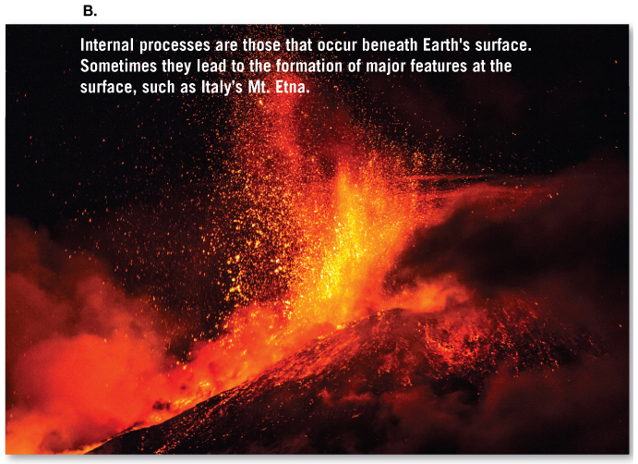
    Geology - science that pursues an understanding of planet earth.
    Physical geology - examines the materials composing earth and seeks to understand the many processes that operate beneath and upon its surface.

Slide 3
    Historical geology - seeks understanding of earth andits development
    Geology, people and environment
    Many important realationship exsist between people and the natural environment
    Problems and issues addressed by geology include:
        natural hazards, resources, world population, growth and evironment issues.

Slide 4
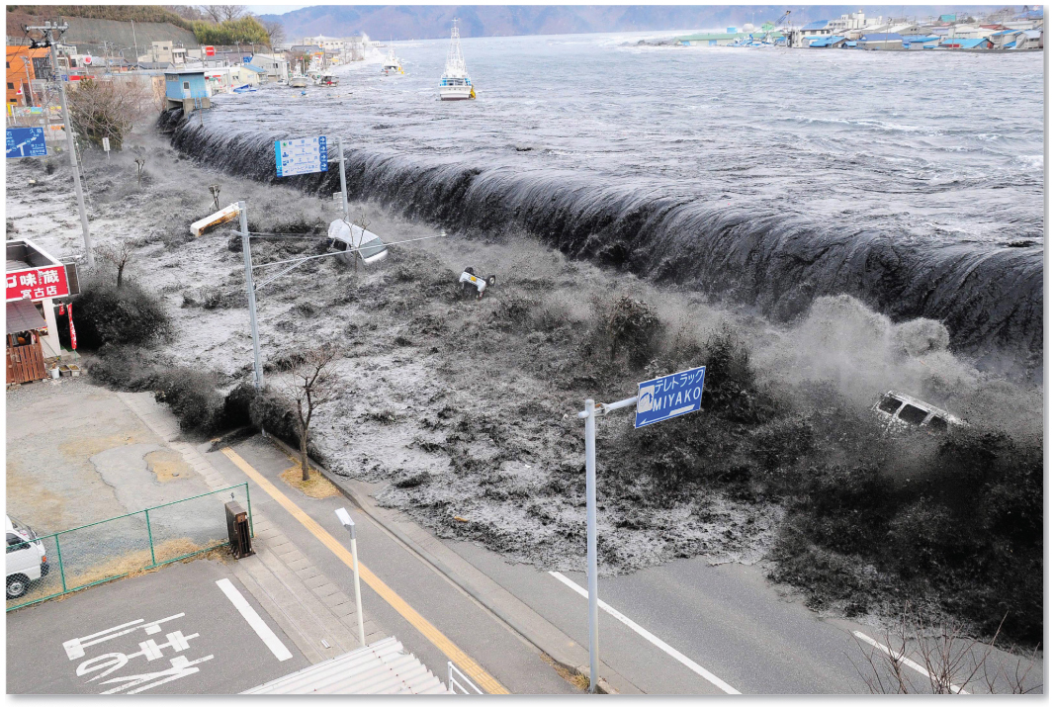
    Tsunami Destruction : Tohoku earthquake (March 11, 2011)

Slide 5
  More people now live in cities than in rural areas
      Creates mega-populations more vulnerable to hazards
  Resources are another important part of geology
      Include water, soil, metallic and nonmetallic minerals, and energyMore people now live in cities than in rural areas

Slide 6
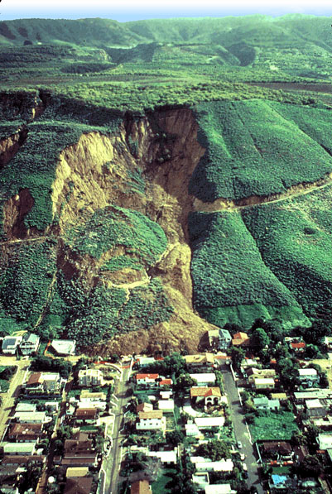
  La Conchita, 1995
  People were warned, evacuated, none killed
  January 10, 2005

Slide 7
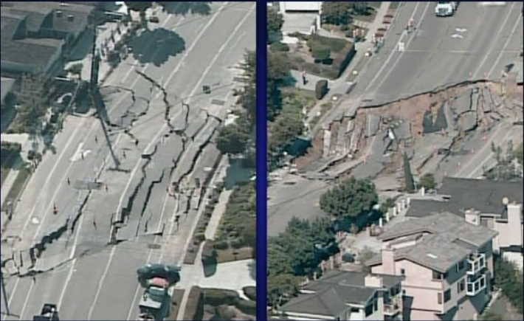
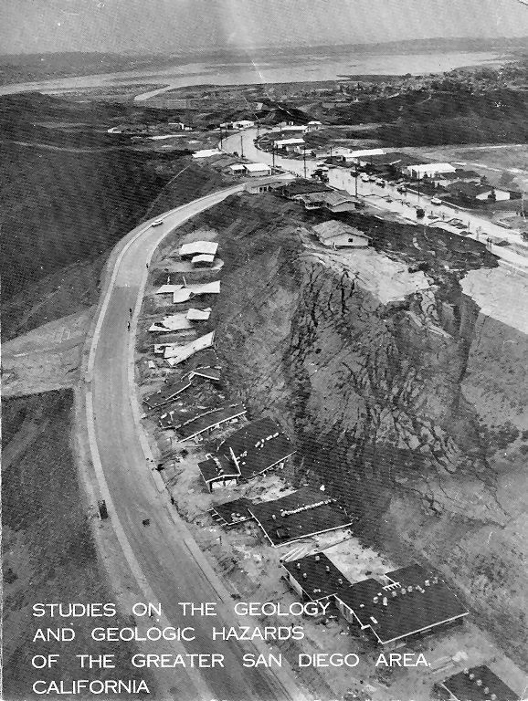

Slide 8
The
  The nature of Earth has been a focus of study for centuries
    Mid 1600s – James Ussher
      Catastrophism
      Earth’s landscapes shaped primarily by catastrophes
    1795 – James Hutton
      Uniformitarianism
      The physical, chemical, and biologic laws that operate today have operated throughout the geologic past
      The present is the key to the past

Slide 9
    Some Gelogic Rates
      Cutting of Grand Canyon
        2 km / 3 m.y. = 1 cm / 15 yr.
      Uplift of Alps
        5 km / 10 m.y. = 1 cm / 20 yr.
      Opening of Atlantic
        5000 km / 180 m.y. = 2.8 cm / yr.
      Uplift of White mountains
        8 km / 150 m.y. = 1 cm / 190 yr.

Slide 10
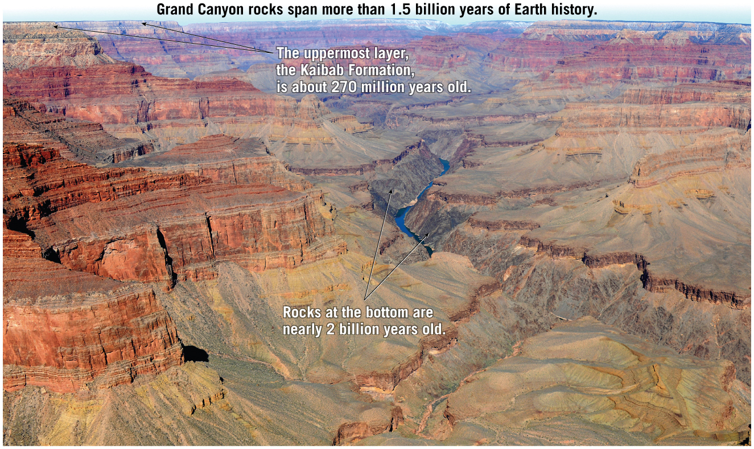

Slide 11
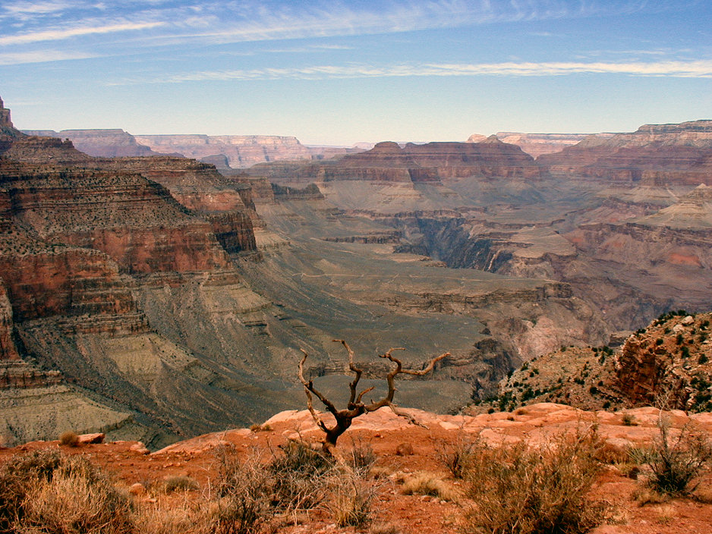
    Grand Canyon from South Kaibab Trail

Slide 12
    Some Gelogic Rates
      Movement of San Andres Fault
        5 km / yr = 7 m / 140 yr.
      Growth of Mt. Helens
        3 km / 30,000 yr = 10 cm / yr.
      Deposition of Niagara Dolomite
        100 m / 1 m.y. = 1 cm / 100 yr.

Slide 13
  Some historical notes about geology
    The nature of earth has been a focus of study for centuries
    Catastrophism “ Features such as mountains were produced by sudden worldwide disasters.
    Uniformitarianism and the birth of modern geology. The present is the key past.
    Uniformitarianism
    Continuity of cause and effect
    Apply cause and effect to future prediction
    Apply cause and effect to present technology
    Apply cause and effect to past uniformitarianism

Slide 14
  Geologic Time
  Geologist are now able to assign fairly accurate dates to events in earth history
  Relative dating and the geologic time scale
    Relative dating means that dates are placed in their proper sequence or order without knowing their age in years
    The magnitude of geologic time involves vast times - millions or billions of years
    An appreciation for the magnitude of geologic time is important because many processes are very gradual
    The big difference between geology and other sciences; TIME (Geologically speaking, not much happens in human lifetime)
    Therefore, geologist use millions of years as the standard unit of time.

Slide 15
  Geology Today
    Uniformitarianism still valid
        Some geologic processes are not directly observable but have well-established evidence to suggest they occur.
    Earth processes vary in intensity but still take a very long time to create or destroy major landscape features.
        The magnitude of geologic time involves millions and billions of years
        Earth is 4.6 billion years old

Slide 16
    Age of Earth
    ~ 4,600 million years
    Radioactive minerals
      Radium, Uranium, Lead
    Salts in the ocean and its accumulation (not accurate)
    Fro younger ages, deposits and C ¹⁴

Slide 17
  The nature of scientific inquiry
    Sciences assumes the natural world is consistent and predictable
    Goal of science is to discover patterns in nature and use the knowledge to make predictions
    Scientists collect data through observation and measurements
    How or why things happen is explained using a:
      Hypothesis - a tentative (or untested) explanation
      Theory - a well tested and widely accepted view that the scientific community agrees best explains certain observable facts.

Slide 18
  The nature of scientific inquiry
    Scientific method involves;
      Gathering facts through observation
      Formulation of hypotheses and theories
    There is no fixed path that scientists follow that leads to scientific knowledge

Slide 19
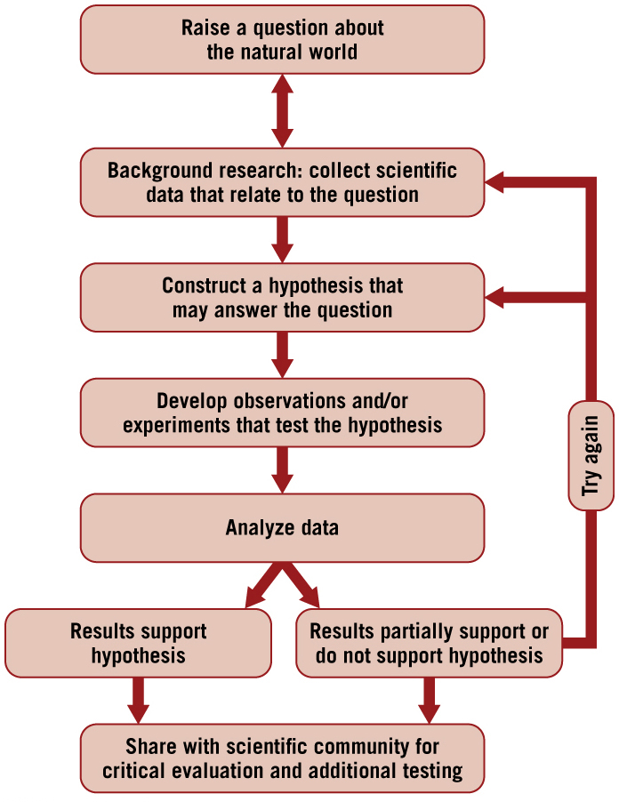

Slide 20
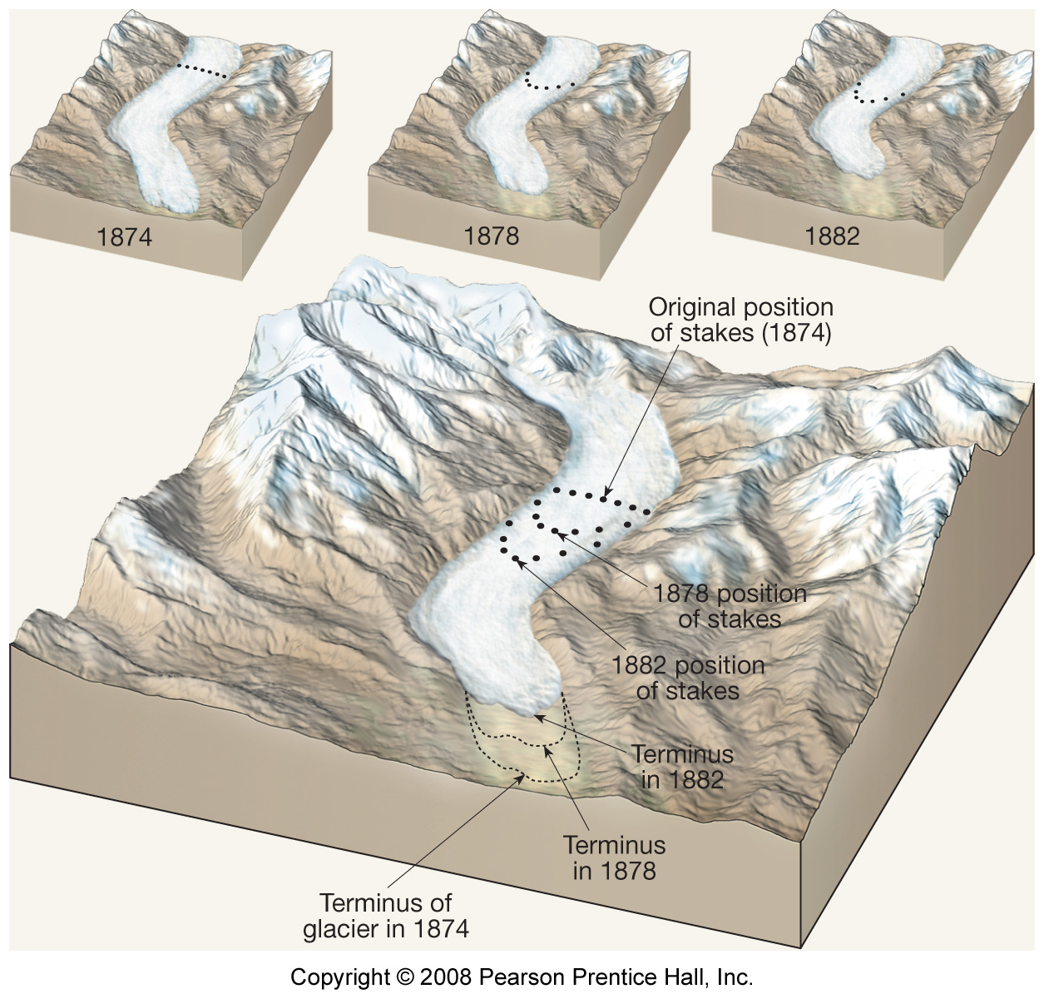
  Field Studies

Slide 21
  Earth as a System
  Earth is a dynamic body with many separate, but interacting, parts:
    Hydrosphere - global ocean and fresh water
    Atmosphere - gaseous envelope
    Geosphere - the solid Earth
    Biosphere - all plant and animal life

Slide 22
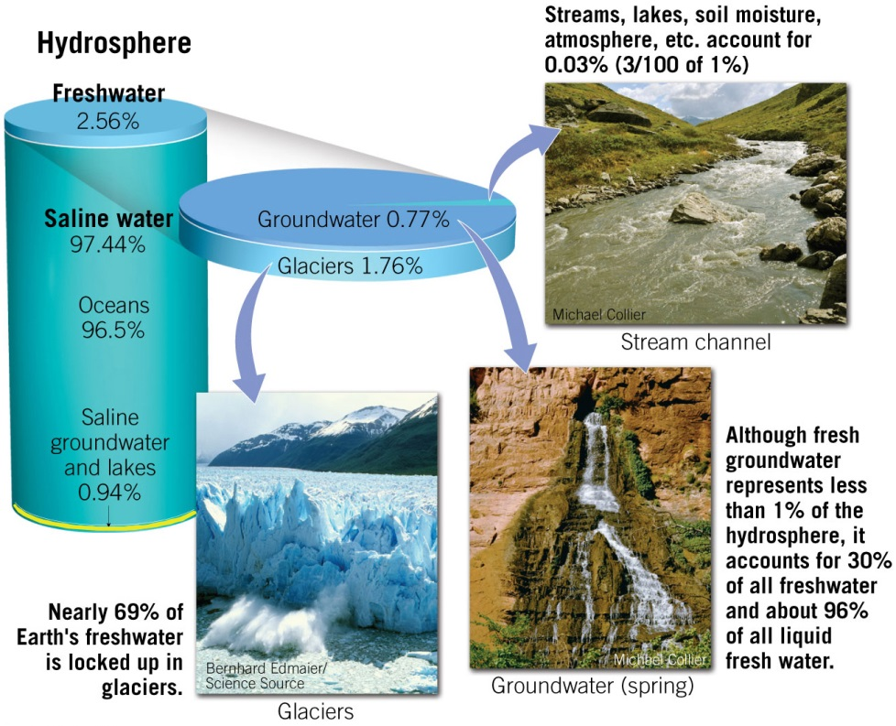

Slide 23
  A system is a group of interacting parts that form a complex whole.
  Earth system science:
    Aims to study Earth as a system composed of numerous interacting parts
    Employs an interdisciplinary approach to solve global environmental problems
  Processes that characterize the Earth system vary on spatial and temporal scales and are powered by energy from the Sun and heat from the Earth’s interior.

Slide 24
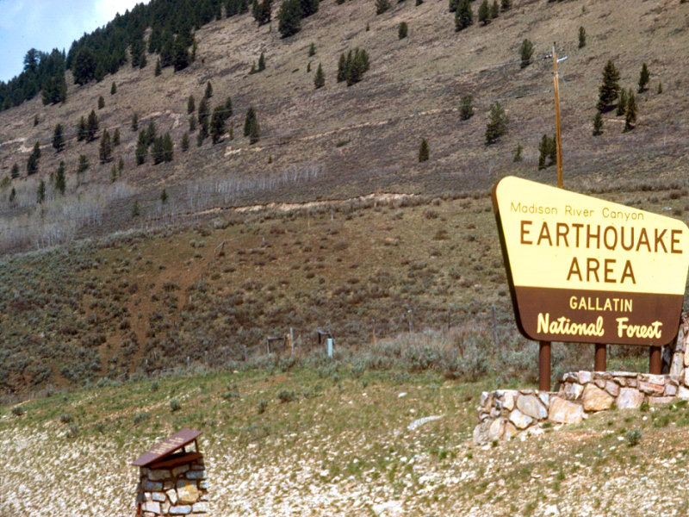
  Sources of Energy
  Heat from the earth’s interior
  - Powers the internal processes
  that produce volcanoes,
  earthquakes, and mountains

Slide 25
  Origin and Early Evolution of Earth
  Origin of our Solar System
    The universe began with the Big Bang.
    The components of the solar system formed at essentially the same time out of the same material.
    The nebular theory proposes that the bodies of our solar system evolved from an enormous rotating cloud called the solar nebula.

Slide 26
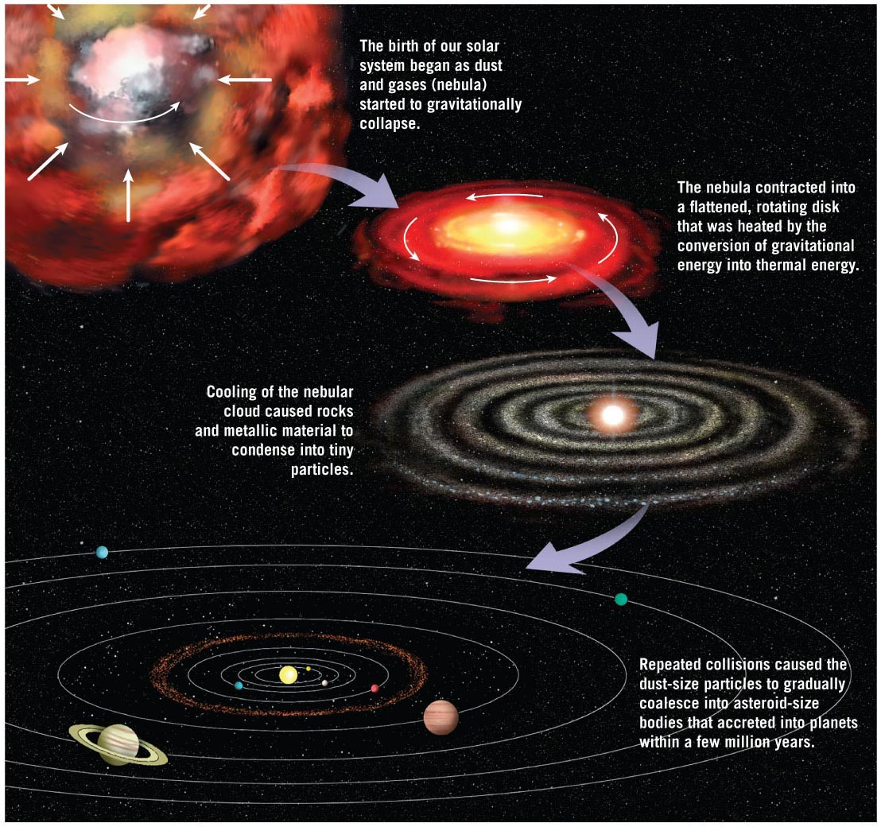
Origin and Early Evolution of Earth
Nebula Theory

Slide 27
Nebular Theory
    The solar nebula consisted of hydrogen, helium, and microscopic dust grains.
    A disturbance caused the solar nebula to slowly contract and rotate.
    The solar nebula assumed a flat, disk shape with the protosun (pre-Sun) at the center.
    Inner planets began to form from metallic and rocky substances.
    Larger outer planets began forming from fragments of ices (H₂O, CO₂, and others).

Slide 28
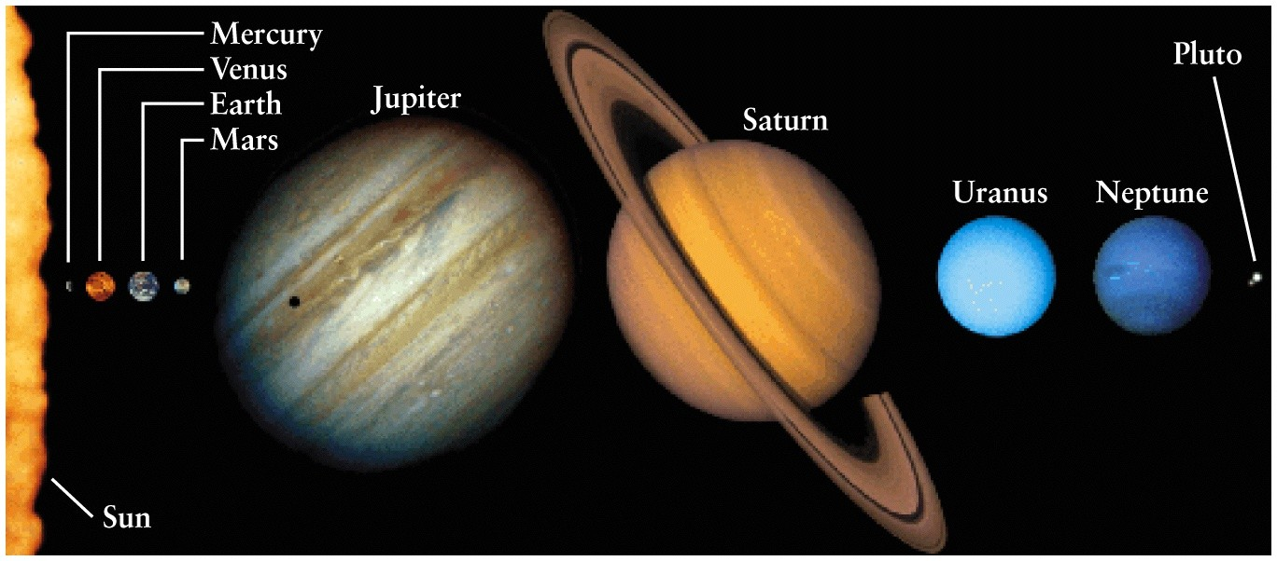
Nebular Hypothesis
  Inner planets – high temp’s, weak gravitational fields, unable to grab lighter elements
  Outer planets – colder, huge amounts of lighter elements

