Slide 1
    Geology for Engineers
    (WED. 1:00pm - 4: 00pm)
^{1st} Sem. SY 2025 - 2026
Aug. 6, 2025

Slide 2
    The term geology is derived from the Greek words
    “GEO” = Earth and “LOGOS” = Study or discourse.
    Therefore Geology is a branch of science that deals with the study of planet Earth.
    Geology is traditionally divided into two broad areas - physical and historical.
    Physical geology deals with the material the Earth is composed of and the many processes that operate beneath and on the surface of the Earth.
    Historical geology talks about the origin of Earth
    and its development through time.

Slide 3
  BRANCHES OF GEOLOGY
  1. PHYSICAL GEOLOGY
    PETROLOGY – Study of rocks (igneous, metamorphic, and sedimentary petrology) and how they form in their specific environment.
    MINERALOGY – Study of minerals, their crystalline and chemical structures and their properties
    CRYSTALLOGRAPHY – Study of the arrangement and bonding of atoms in crystalline solids and with the geometric structure of crystal
    HYDROGEOLOGY – Area of geology that deals with the distribution and movement of groundwater in the soil and rocks of the Earth's crust.
    LITHOLOGY – Study of the classification of rocks based on their physical and chemical properties.

Slide 4
  (cont...)
  f) STRUCTURAL GEOLOGY
    Also known as GEOTECTONIC or TECTONIC geology
    The study of the three-dimensional distribution of rock units with respect to their deformation history
    Deals with the internal structure of rocks which may result to the occurrence of faults, joints and folds
  g) GEOPHYSICS – Branch of geology that uses physics to examine the earth's structure, climate, and oceans.
  h) BEDROCK GEOLOGY – How the intact, solid rock beneath surficial
  sediments formed including age (stratigraphic sequences), morphology and rock properties (folds, faults, fractures).
  i) GEOMORPHOLOGY - The study of the physical features of the Earth’s surface and its relation to its geological structure. Deals with the development / transformation of its landforms.
  j) GEOPHYSICS – The study of the physical properties of earth (e.g. Density, magnetism, texture, etc)

Slide 5
  (cont...)
  2. HISTORICAL GEOLOGY
    a) STRATIGRAPHY - Concerned with the order and relative position of strata and their relationship to geological time scale. Used for study of archaeological remains
    b) PALEONTOLOGY - Deals with the study of life of geologic past. Involves the analysis of plant and animal fossils preserved in rocks
    c) OCEANOGRAPHY - Deals with the study of all aspects of the ocean. Includes marine life and ecosystem
  ALLIED BRANCHES - applies knowledge of geology in other sciences and/or field
  1. ENGINEERING GEOLOGY/ GEOLOGY ENGINEERING
    ▪ application of geology in Civil Engineering
  2. MINING GEOLOGY
    ▪ application of geology in Mining Engineering
  3. GEOHYDROLOGY / HYDROGEOLOGY
    ▪ deals with groundwater movement

Slide 6
  IMPORTANCE OF GEOLOGY IN CIVIL ENGINEERING
  Geology is the study of earth, the materials of which it is made, the structure of those materials and the effects of the natural forces acting upon them and is important to civil engineering because all work performed by civil engineers involves earth and its features.
  Fundamental understanding of geology is so important that it is a requirement in university_x0002_level civil engineering programs.
  For a civil engineering project to be successful, the engineers must understand the land upon which the project rests.
  Geologists study the land to determine whether it is stable enough to support the proposed project. They also study water patterns to determine if a particular site is prone to flooding.
  Some civil engineers use geologists to examine rocks for important metals, oil, natural gas and ground water.

Slide 7
  ROLE OF ENGINEER IN THE SYSTEMATIC
  EXPLORATION OF A SITE
  The investigation of the suitability and characteristics of sites is an important pre-requisite for any engineering projects as they affect the design and construction of civil engineering works and the security of neighboring structures.
  A professional engineer must have some basic ideas related to geology and site exploration.
  The primary objective of a site investigation is to determine as accurately as may be required -

Slide 8
  (cont...)
  The nature and sequence of strata;
  The ground water conditions at the site;
  The physical properties of soil and rock underlying the site;
  The mechanical properties, such as strength and compressibility of different soil or rock strata, and
  Other specific information, when needed, such as the chemical composition of the groundwater, and the characteristics of foundations of the adjacent structure.

Slide 9
  (cont...)
  The systematic exploration and investigation of a new site involves five
  stages of procedure. These stages are:
    preliminary investigation using published information and other existing data;
    a detailed geological survey of the site, possibly with a photogeology study;
    applied geophysical surveys to provide information about the subsurface geology;
    boring, drilling and excavation to provide confirmation of the previous results, and quantitative detail, at critical points on the site; and
    testing of soils and rocks to assess their suitability, particularly their mechanical properties (soil mechanics and rock mechanics), either in situ or from samples.

Slide 10
  (cont...)
  In a major engineering project, each of these stages might be carried
  out and reported on by a consultant specializing in geology, geophysics or engineering (with a detailed knowledge of soil or rock mechanics).
  However, even where the services of a specialist consultant are employed, an engineer will have overall supervision and responsibility for the project.
  The engineer must therefore have enough understanding of geology to know how and when to use the expert knowledge of consultants, and to be able to read their reports intelligently, judge their reliability, and appreciate how the conditions described might affect the project.

Slide 11
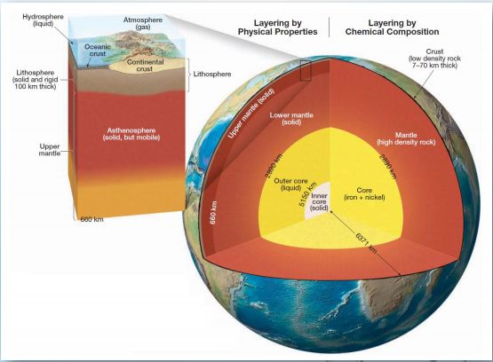
  EARTH STRUCTURE

Slide 12
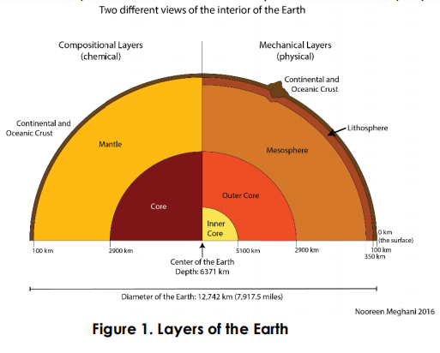

Slide 13
  STRUCTURE OF THE EARTH
  ▪ The structure of the Earth consists of various spherical shells or layers that can be categorized in two manners:
    a) Chemical/ Elemental compositions
    b) Mechanical/physical properties
  COMPOSITIONAL (CHEMICAL) LAYERS OF EARTH
  ▪ more commonly discussed layers of earth; layers are defined based on its chemical or elemental composition

Slide 14
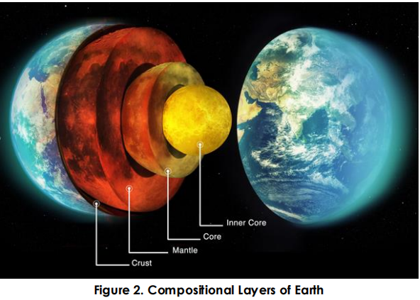

Slide 15
  The age of Earth is put at about 4.6 billion years.
  • Segregation of material that began early in Earth’s history resulted in the formation of three layers defined by their chemical composition - the crust, mantle, and core.
  • Earth can be divided into layers based on physical properties.
  • The physical properties used to define such zones include whether the layer is solid or liquid and how weak or strong it is.
  • Knowledge of both types of layered structures is essential to our understanding of basic geologic processes, such as volcanism, earthquakes, and mountain building.

Slide 16
  1. CRUST
  The crust, Earth’s relatively thin, rocky outer skin, is of two different types — continental crust and oceanic crust. Both share the word “crust,” but the similarity ends there.
  The oceanic crust is roughly 7 kilometers thick and composed of the dark igneous rock basalt.
  By contrast, the continental crust averages about 35 kilometers thick but may exceed 70 kilometers in some mountainous regions such as the Rockies and Himalayas.
  Unlike the oceanic crust, which has a relatively homogeneous chemical composition, the continental crust consists of many rock types.
  Continental rocks have an average density of about 2.7 g/cm3, and some have been discovered that are 4 billion years old.
  The rocks of the oceanic crust are younger (180 million years or less) and denser (about 3.0 g/cm3) than continental rocks.*

Slide 17
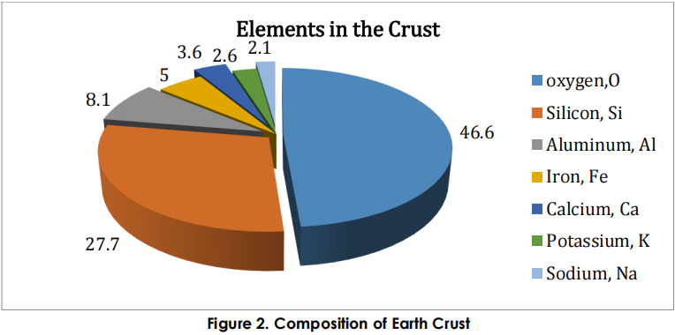

Slide 18
  2. MANTLE
  More than 82 percent of Earth’s volume is contained in the mantle, a solid, rocky shell that extends to a depth of nearly 2900 kilometers .
  The boundary between the crust and mantle represents a significant change in chemical composition.
  The dominant rock type in the uppermost mantle is peridotite, which is richer in the metals magnesium and iron than the minerals found in either the continental or oceanic crust.
  **CONDUCTION
  – heat transfer through rapid collision of atoms which only happens in solid
  – heat flows from warmer to cooler places until it reaches same temperature
  **CONVECTION
  – process of material that can move and flow and develops convection currents

Slide 19
  UPPER MANTLE
  The upper mantle extends from the crust-mantle boundary down to a depth of about 660 kilometers. The upper mantle can be divided into two different parts.
  The top portion of the upper mantle is part of the stiff lithosphere, and beneath that is the weaker asthenosphere.
  The lithosphere (sphere of rock) consists of the entire crust and uppermost mantle and forms Earth’s relatively cool, rigid outer shell.
  Averaging about 100 kilometers in thickness, the lithosphere is more than 250 kilometers thick below the oldest portions of the continents.
  Beneath this stiff layer to a depth of about 350 kilometers lies a
  soft, comparatively weak layer known as the asthenosphere.

Slide 20
  LOWER MANTLE
  From a depth of 660 kilometers to the top of the core, at a depth of 2900 kilometers, is the lower mantle.
  Because of an increase in pressure (caused by the weight of the rock above) the mantle gradually strengthens with depth.
  Despite their strength however, the rocks within the lower mantle are very hot and capable of very gradual flow.

Slide 21
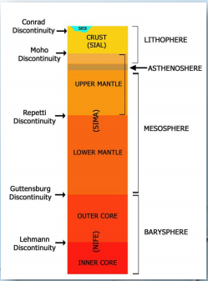
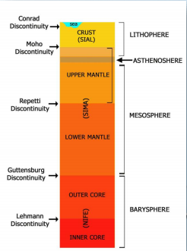
  UPPER MANTLE LOWER MANTLE

Slide 22
  3. CORE
  The composition of the core is thought to be an iron-nickel alloy.
  At the extreme pressure found in the core, this iron-rich material has an average density of nearly 11 g/cm3 and approaches 14 times the density of water at Earth’s center.
  The core is divided into two regions that exhibit very different mechanical strengths.
  The outer core is a liquid layer 2270 kilometers thick. It is the movement of metallic iron within this zone that generates Earth’s magnetic field.
  The inner core is a solid sphere having a radius of 1216 kilometers.
  Despite its higher temperature, the iron in the inner core is solid due to the immense pressures that exist in the center of the planet.

Slide 23
  a. Inner core
    ▪ Solid part of the core made of iron
    ▪ Has a radius of about 760 miles according to NASA
    ▪ Hottest layer of earth at 7000°C
  b. Outer core
    ▪ Liquid part of the core composed of nickel-iron alloy
    ▪ About 1,355 miles thick
    ▪ Temperature at 5000°C

Slide 24
  MECHANICAL (PHYSICAL) LAYERS OF EARTH
  ▪ layers of earth defined and divided based on the behaviors of the layers; corresponds
  to the mechanical properties of the layers
  a) LITHOSPHERE
  ▪ the solid, outer part of the Earth; includes the brittle upper portion of the mantle and
  the crust, the outermost layers of Earth's structure
  ▪ bounded by the atmosphere above and the asthenosphere
  ▪ sometimes called the Geosphere itself
  b) ASTHENOSPHERE
  ▪ the soft upper layer of the earth's mantle, below the lithosphere,
  ▪ relatively low resistance to plastic flow and convection is thought to occur.
  c) MESOSPHERE:
  ▪ layer below the asthenosphere but above the outer core; essentially the lower
  mantle.

Slide 25
  ▪ Despite high temperatures, the intense pressure in this region restricts the
  movements of the molecules of the silicate material despite being under high
  temperature, thus making it extremely rigid.
  d) OUTER CORE
  ▪ extends from the bottom of the mesosphere or the lower mantle and surrounds the
  inner core
  ▪ extreme temperature allows metals to remain in their liquid phases
  ▪ the only layer of the Earth that is a true liquid
  ▪ Strong magnetic field is caused by convection
  e) INNER CORE
  ▪ solidity is due to the intense pressure from the upper layers
  ▪ Spins at different speed than the rest of the planet, which is thought to cause the
  Earth’s magnetic field

Slide 26
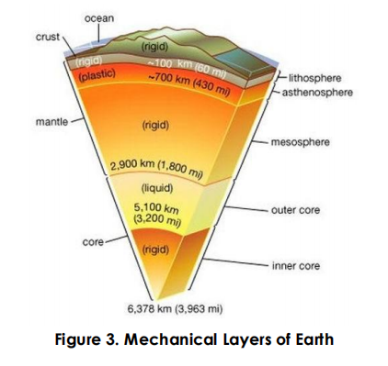

Slide 27


