Slide 1

UTS Finals Topic:
Learning and Caring for Self
Understanding the Self – UTS111

Slide 2

Lesson 1: The Better Learner
Understanding the Self – UTS111
Learning Objectives:
At the end of the lesson the students are expected to:
1. Identify the function of Education.
2. Understand the metacognition and learning strategies.
3. Manage one’s own learning.
The Better Learner

Slide 3
The Better Learner
Understanding the Self – UTS111
“Education is the most powerful weapon by which you can change the world.”
-Mandela
But the question is… if education is a powerful weapon is it key to individual success? Or is it one’s diskarte?
The Better Learner

Slide 4
The Better Learner
Understanding the Self – UTS111
The self - concept is a rich and complex social representation. In addition to people’s thoughts about who they are right now, the self concept includes thoughts about their past self – experiences, accomplishment and failures.
Education is a group’s formal system of teaching knowledge, values, and skills. Such instruction stood in marked contrast to the learning of traditional skills such as farming or hunting, for it was clearly intended to develop the mind. Consequently, one’s self – concept will be enhanced.
The Better Learner

Slide 5
Functions of Education
Understanding the Self – UTS111
Teaching knowledge and skills. Most obvious manifest function of education is to teach knowledge and skills. Society must train the next generation to fulfill its significant position.
Cultural Transmission and Social Integration. Education is an instrument of social improvement where a person gains happiness as valuable by product.
Promoting Personal Change. School teach students o think for themselves and critically evaluate the ideas and social life.
Promoting Social Change. The continuous aim of education to unravel more new profound ideas enable humankind to progress better and evolve much wiser.
Mainstreaming. Education helps to incorporate people with abilities to participate into regular activities.
The Better Learner

Slide 6
Functions of Education
Understanding the Self – UTS111
Education in the Philippines is viewed as a key investment to break poverty cycle, it provides the Filipino youth with knowledge and skills to actively participate in productive and profitable activities aimed to improved the quality of life.
The Better Learner

Slide 7
Cognitive and Metacognitive of Learning
Understanding the Self – UTS111
Nature of Learning Process
Finding purpose in learning is necessary.
Goals of the Learning Process
The learner must find meaning coherence and representation of knowledge.
Construction of Knowledge
Can link new information form previous one.
Strategic Thinking
Ability to create and use stock of thinking and reasoning strategies to achieve complex goals.
Thinking about thinking
Mental monitoring to facilitate creative and critical thinking.
Context Learning
Able to make use of surrounding as a source of learning .
Psychologists provide important information on human learning, development and motivation. Example is Cognitive and Metacognitive process of learning.
Cognitive skills include instructional objectives, components in a learning hierarchy, and components in information processing. Metacognitive skills include strategies for reading comprehension, writing, and mathematics. Motivational skills include motivation based on interest, selfefficacy, and attributions (APA, 2005).
The Better Learner

Slide 8
Rules of Learning
Understanding the Self – UTS111
Learning requires practice
Distributed learning is favorable better than cramming.
Learning should be meaningful
Learning is
Helped by feedback
Learning is active
Learning is a permanent change in behavior brought by experience, maturation, and performance.
The Better Learner

Slide 9
Types of Learner
Understanding the Self – UTS111
We mentioned before that scientists have for years tried to understand the best ways students learn through research. One of the popular theories, to this day, is the VARK model. This model identifies four types of learners: visual, auditory, kinesthetic, and reading/writing.
Most people are a combination of these four styles, but more times than not, they have a predominant style of learning. Each of these styles has a complementary way of teaching. Now, let’s see the characteristics each of these styles entails and how best to make use of them (Bay Atlantic University, 2024).
Audio
Take in information in auditory form when it is heard or spoken.
Visual
Learn using different visual aids such as patterns and shapes.
Kinesthetic
Individuals who prefer to learn by doing. They enjoy a hands-on experience.
Read/Write
Consume information best when it’s in words, whether that’s by writing it down or reading it.
VARK Model
The Better Learner

Slide 10
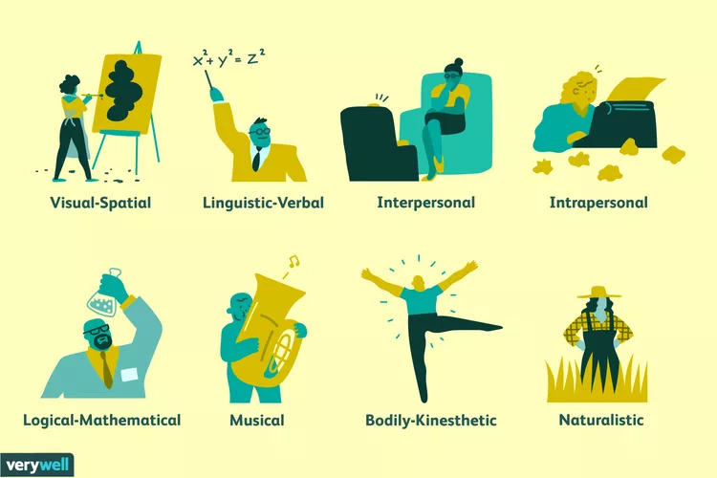
Types of Intelligence
Understanding the Self – UTS111
The concept of multiple intelligences is a theory proposed by Harvard psychologist Howard Gardner. When you hear the word intelligence, the concept of IQ testing may immediately come to mind. Intelligence is often defined as our intellectual potential; something we are born with, something that can be measured, and a capacity that is difficult to change.
In recent years, however, other views of intelligence have emerged, including Gardner's suggestion that multiple different types of intelligence may exist.
The Better Learner

Slide 11
Do you study to learn or just because you need to?
Understanding the Self – UTS111

Slide 12
Lesson 2: The Goal Settings
Understanding the Self – UTS111
Learning Objectives:
At the end of the lesson the students are expected to:
1. Identify the importance of goals.
2. Understand different concepts and theories of goals setting.
3. Learn to set goals.
Goal Settings

Slide 13
Lesson 2: The Goal Settings
Understanding the Self – UTS111
“The future belongs to those who believe in the beauty of their dreams”
-Eleanor Roosevelt
Goal Settings

Slide 14
Understanding the Self – UTS111
What is your childhood dream?
What is your dream now?
Goal Settings

Slide 15
Searching for Goals
Understanding the Self – UTS111
To set goals is easy but to set the right goals is quite difficult as one as seems to think. Carl Rogers attest that the source of psychological distress is incongruence or one’s ideal self does not sufficiently overlap with his/her concept.
Alfred Adler who is regarded as the father of Individual Psychology conceptualize the term “inferiority complex”. Something arouse from sense of inferiority or inadequacy.
Herbert Harry Sullivan prosed that human being are driven towards two source of motivation; the pursuit of satisfaction and the pursuit of security.
This theories underscores that individual have organic valuing process that is natural instinct directing people to the most fulfilling pursuit and therefore innate in them to set goals for the future and plan for its achievement.
Goal Settings

Slide 16
The importance of Goals – Bandura Self Efficacy
Understanding the Self – UTS111
Self- efficacy
Mastery Experience
Experimenting with realistic and challenging goals.
Social Modeling
Choosing a role model that can demonstrate self- efficacy.
Social Persuasion
Looking for right mentor who practices what he/she teaches.
State of Physiology
Condition that can influence their interpretation of self – efficacy.
Self – efficacy is person’s belief about his capabilities to produce designated levels of performance that influence one’s event that affect his life. Self – efficacy belief determines how people feel, think, behave and motivate himself.
Bandura (2008) believes that self – efficacy is the ability to influence events that affects one’s life and control over these event that experienced.
Goal Settings

Slide 17
How Self –efficacy Influence the self?
Understanding the Self – UTS111
Self- efficacy
Cognitive
Thinking is self- enhancing (optimistic) or deliberating (pessimistic) ways can greatly influence functioning.
Motivational
Value of motivation influence an outcome. Can I reach my goal?
Emotional
A person then is able to grow competent in his self – efficacy to deal with his emotional challenges. This relate to emotional challenges.
Decisional
There is a choice when it comes to how to choose to experience one’s situation. One can choose best environment suited for growth and development.
Bandura (2008), explained how the degree to which someone believes in his own self – efficacy influence his functioning. This is expressed in four categories: cognitive, motivational, emotional and decisional.
Goal Settings

Slide 18
The importance of Goals – Bandura Self Efficacy
Understanding the Self – UTS111
Self - awareness
Coping Skills
Interpersonal Skills
Effective Relationship
Personal and Interpersonal Relationship
Different individuals may establish different goals to achieve at their own good time frame. Regardless of the differences in goal settings, it will all be founded in self – awareness, having a good groundwork of knowing oneself will be enough to develop coping skills in terms of setbacks and failure, which in turn will enhance one interpersonal skills.
Goal Settings

Slide 19
“Dreams do not work unless you do.”
- John C. Maxwell
Understanding the Self – UTS111
D – Determine to fulfill your dream.
R – Recognize your role and the people who can help you to fulfill your dreams.
E – Eliminate unhealthy habits and attitudes.
A – Accept possibilities, criticism, disappointment and failure.
M – Make your dream happen.
It is greatly recommended to create concrete plan of action for overcoming any obstacle and pursue your dreams.
Goal Settings

Slide 20
Understanding the Self – UTS111
What you want to become?
Goal Settings

Slide 21
Lesson 3: Taking Charge of One’s Health
Understanding the Self – UTS111
Learning Objectives:
At the end of the lesson the students are expected to:
1. Identify the stressor and healthy response.
2. Locate the sources of coping and strength.
3. Learn o take care the Self.
Taking Care of One’s Health

Slide 22
Definition of Stress
Understanding the Self – UTS111
Stress
Pleasant Stress (Eustress)
Unpleasant stimulus but becomes source of motivation.
Neustress
Neutral or negative stress caused by a disturbing event that does not affect a person directly .
Negative Stress (Distress)
Causes pain in the mind and body that literally make a person sick.
Hans Selye states that stress is the term used to denote Physical, Emotional, Cognitive and behavioral responses that is threatening and challenging.
Taking Care of One’s Health

Slide 23
Sources of Stress
Understanding the Self – UTS111
Stressors have a major influence upon one’s mood, one’s sense of well – being, behavior and health. Acute stress responses in young. Healthy individuals may be adaptive and typically do not impose a health burden. However, if the threat is unremitting particularly in older or unhealthy individual, the long term effect of stressor can damage. Following are the common stressors for young adult.
School demand and expectations.
Romantic relationship or lack of it.
Family demand and expectations
Demands of Social life.
Separation anxiety
Taking Care of One’s Health

Slide 24
Understanding the Self – UTS111
Frustration
Emotional state caused when one is blocked from attaining a goal.
Pressure
Emotional state when one is faced with personal responsibilities that imposed on one’s abilities.
Trauma
A shocking physical or emotional experience.
Psychological Stress maybe classified into frustration, pressure, and trauma.
Taking Care of One’s Health

Slide 25
Coping with Stress (Emotion – focused Coping)
Understanding the Self – UTS111
Behavioral
When one learned to reassess situation to minimize the effects of stress.
Physical
Individual cope with stress by changing physical responses.
Cognitive
A method by which involves changing or interpreting the stressor.
Taking Care of One’s Health

Slide 26
Psychological Stress Reaction
Understanding the Self – UTS111
Physical Stress
Reaction
Anxiety Unpleasant emotion characterized by apprehension, tension and fear.
Anger and Aggression
Common reaction to stress.
Apathy and Depression
Is a frequent response to fraustration.
Cognitive Impairment
Difficulty to think and concentrate.
Fight or Flight
A person prepares the person to face or free (get away) an immediate threat
Taking Care of One’s Health

Slide 27
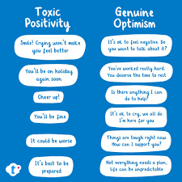
Toxic Positivity
Understanding the Self – UTS111
Toxic positivity is the expectation to maintain a positive attitude in all situations, even when it's not realistic or helpful. It can involve invalidating or suppressing negative emotions, and can lead to feelings of guilt, anxiety, and alienation.
Taking Care of One’s Health

Slide 28
Understanding the Self – UTS111
How can you express yourself positively?
Taking Care of One’s Health

Slide 29
End of Presentation
Understanding the Self – UTS111
Thank you!

