Slide 1

Understanding the Self
(Midterm Topics)

Slide 2
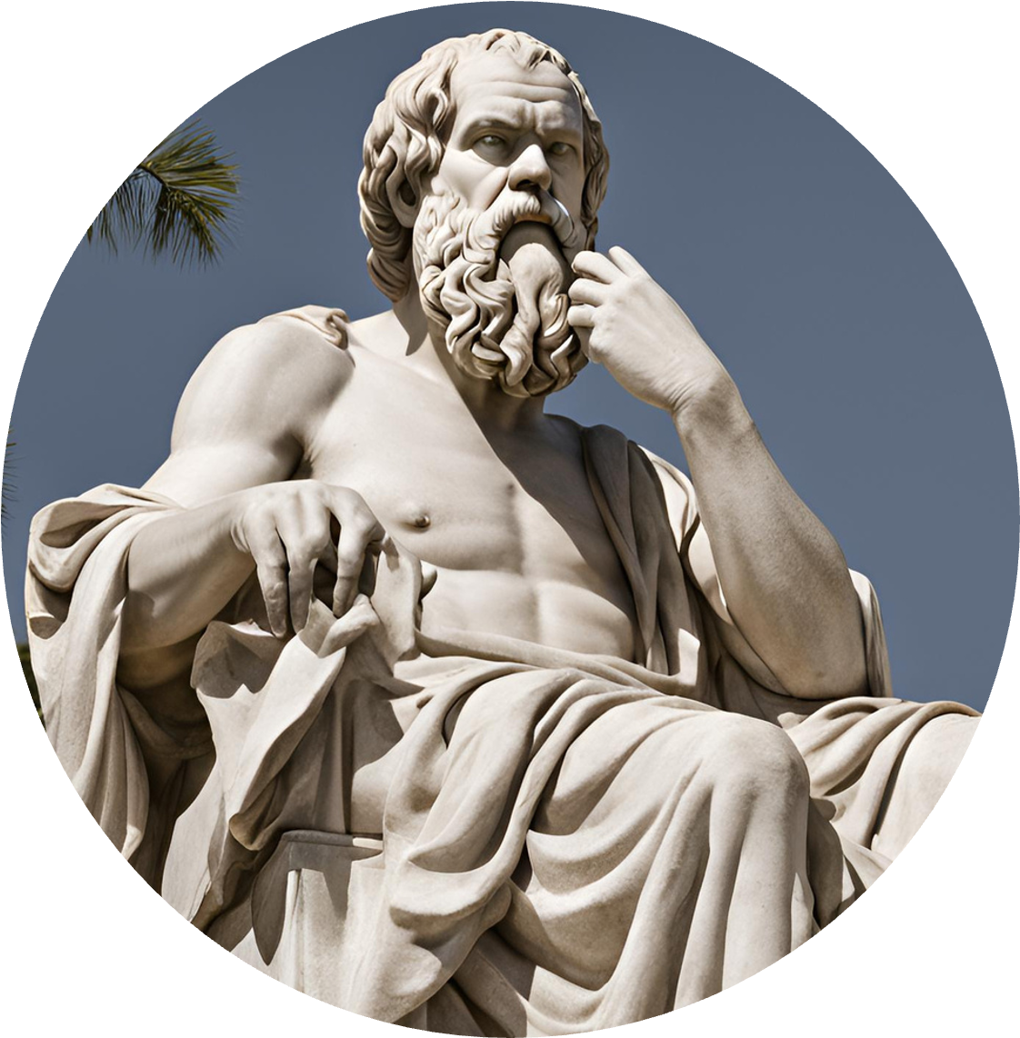
I. Physical Self
Objectives:
At the end of the discussion, you should be able to:
1. Explain the concept of physical self.
2. Discus ways on how to observe physical self- care.
3. Enumerate practical tips on how to practice physical self- care; and
Physical Self

Slide 3

INTRODUCTION
” The physical body is conceived and constructed in consciousness as are the time and space. All happens within our self”
. Deepak Chopra
“Physical fitness is not only one of the most important keys to healthy body, it is the basis of dynamic and creative activity”.
John F. Kennedy.
Physical Self

Slide 4
ABSTACTION
The physical body is the window to one’s personality. By merely looking at someone’s physical features, you can have an idea of his or her own feelings, thoughts, and behavior.
Much our resources has also been devoted the beauty products and treatments in order to improve the way we look, because we want others to have good impression of who we are.
Physical Self

Slide 5
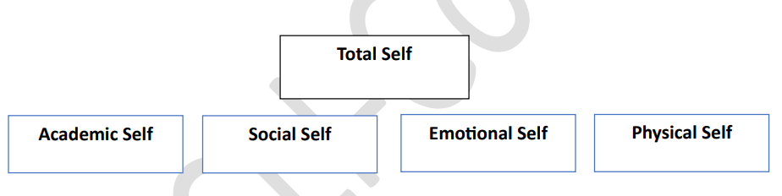
Shavelson described the total self or general self as being made up of academic self and nonacademic self. Academic self is influenced by the learning process and the individual's emotions, behavior, and experiences during the learning process Nonacademic self is shaped by an individual's social self, emotional self, and physical self. The social self is greatly influenced by parents, colleagues, friends and acquaintances among others. Emotional self is the person's experiences of joy, anger, fear, anxiety, and other emotions. On the other hand, physical self is affected by involvement in sports, exercise, and other activities that enhance the physical body (Medišauskaite 2009).
Physical Self

Slide 6
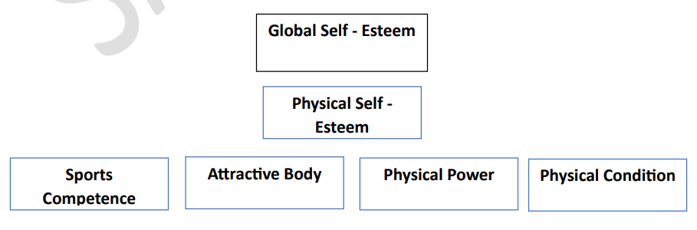
KR Fox (2000) emphasized the factors that encompass physical self-esteem, which include sport competence, attractive body, physical power and physical condition, and how they actually shape the global self-esteem.
Physical self is the amazing vessel, complex woven and knitted, finely tuned creature with which we interact with our environment and fellow beings. The physical self is the concrete dimension, the tangible aspect of the person that can be directly observed and examined. It is composed of systems that receive and respond to various external and internal stimuli.
Physical Self

Slide 7
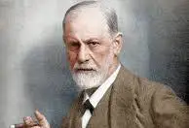
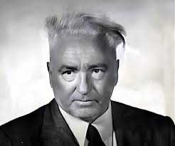
Theoretical Foundation of Physical Self
Sigmund Freud's concept of self and personality makes the physical body the core of human experience. Freud stated that ego is first and foremost a body ego. Moreover, Wilhelm Reich emphasized the unity of the mind and body. The body is central to all dynamic psychological functioning and it plays a very important role in storing and channeling the bioenergy, which is considered as the basis of human existence and experience (Singh 2020).
Sigmund Freud
Wilhelm Reich
Physical Self

Slide 8
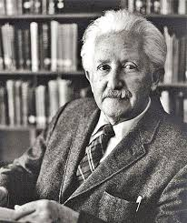
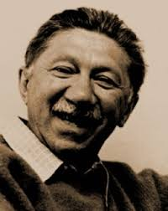
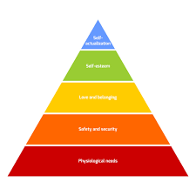
Theoretical Foundation of Physical Self
Meanwhile, Erik Erikson considered experience as firmly associated on the ground-plan of the body He stated that organs of the body are essential during the early developmental stages of a person. Maslow provided a very important lesson about our physical bodies when he laid down Maslow's Hierarchy of Needs Once the physiological needs are met, the person becomes dedicated to attaining the higher-order needs.
Erik Erikson
Abraham Maslow
Physical Self

Slide 9
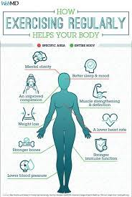
Taking Care of Physical Self
The physical body has been considered as the “real home" "temple” or "Vehicle". It is the only one that we have throughout our entire lives and is also the one most intimate to us.
Self-care is the intentional, planned, and actual act of taking the time to attend to our basic physical, mental, and emotional needs (Brzosko 2018). It is quality rest that we offer to our bodies in order to replenish the lost energy utilized in performing our daily activities.
Physical Self

Slide 10
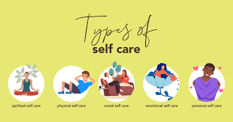
Taking Care of Physical Self
This aspect of self-care is the simplest one and is very common nowadays. There are three basic aspects of physical self-care, and these include good nutrition, sufficient amount of recovery time (rest and sleep), and necessary exercise. Others might have other ways to care for the body depending on the specific need and preferences, like breathing exercises, massages, long baths, saunas. physiotherapy, biking, hiking, skin care, and more.
Physical Self

Slide 11
II. Sexual Self
At the end of this lesson, you should be able to:
1 describe the concept of sexual self,
2 recognize your own sexual self and behavior, and
3. discuss ways on how to protect one's sexual self
Physical Self

Slide 12
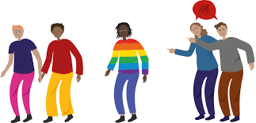
Sex versus Gender Expression
Sex refers to the physical or physiological differences between males and females, including both the primary sex characteristics (the reproductive system) and the secondary characteristics, such as height and muscularity (Diamond 2002). Sex is therefore, defined by the reproductive organs, including the cellular components, the chromosomes, and the hormones. There are three sex variations according to WAAC or Western Australian AIDS Council (2020):
Sexual Self

Slide 13
Sex versus Gender Expression
According to Diamond (2002), gender refers to social or cultural roles played by male or female in the society. Gender identity is the extent to which one identifies as being either masculine or feminine, or how someone feels on the inside (WAAC 2020),
Meanwhile, gender expression describes how someone prefers to express his or her gender to the world. For instance, we have been accustomed to associating color pink to girls and blue for boys. From childhood, we give dolls for baby girls, while trucks or plastic guns for baby boys Men are sporty, while women are encouraged to use makeup, do hairstyle, and paint their nails. There are three gender variations (WAAC 2020).
Sexual Self

Slide 14

Male is a person with the penis or the male reproductive organ, with XY chromosomes in his cells and the body is capable of producing high levels of testosterone.
Female is a person with vagina or the female reproductive organ,
Intersex is a person born with the sexual anatomy or chromosomes that do not fit the traditional definition of male or female The person has the combination of reproductive sex organs, including internal sex organs. chromosomes, and hormones.
Sexual Self

Slide 15
Three Variation of Gender
The first is cisgender who is a person identifying himself or herself with the sex assigned to them at birth. For example, a person who was assigned as a male at birth and identifies as male or vice versa.
The second is transgender whose gender identity does not match the sex that they were assigned at birth For example, a person who was assigned as a male at birth, but identifies as female, or vice versa.
The last type is gender fluid, referring to a person whose gender identity is not fixed and/or shifts depending on the situation. These people do not feel the need to act according to the sex that they were assigned at birth and the associated traditional social roles.
Sexual Self

Slide 16
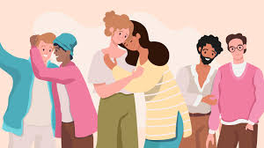
Sexuality
Sexuality pertains to the part of a person expressed through sexual activities and relationships. It is often represented through one's feelings, sexual identity, and behaviors. Sexual identity is how a person chooses to describe or label his or her sexuality
Heterosexual is a person who is attracted to the people of the opposite sex.
Homosexual who is a person attracted to the people of the same sex.
Bisexual is a person who is attracted to both genders-male and female.
Asexual is a person having no sexual attraction.
Pansexual refers to a person's attraction to multiple genders.
Questioning refers to some people who may be unsure about their sexuality and/or are exploring it.
Sexual Self

Slide 17
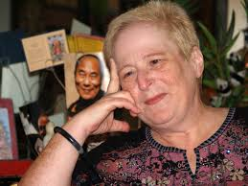
Queer Theory
Queer theory is a perspective that questions the manner in which we have been taught to think about sexual orientation. The proponents of the theory disagree with the idea of labeling and they embrace the term "queer" to describe their group. They do not adhere to the idea of dominant gender schema and the classification of sexual orientations into homosexual and heterosexual. They emphasize the need for a more flexible and fluid conceptualizations of sexuality, one that will permit freedom, negotiation, and change (Little and McGivern, 2020)
Eve Kosofsky Sedgwick
Queer theorist
Sexual Self

Slide 18
III. Material Self
At the end of this lesson, you should be able to:
1 describe the concept of material self,
2 recognize your own consumer behavior, and
3. discuss ways on how to protect one’s material self
Material Self

Slide 19
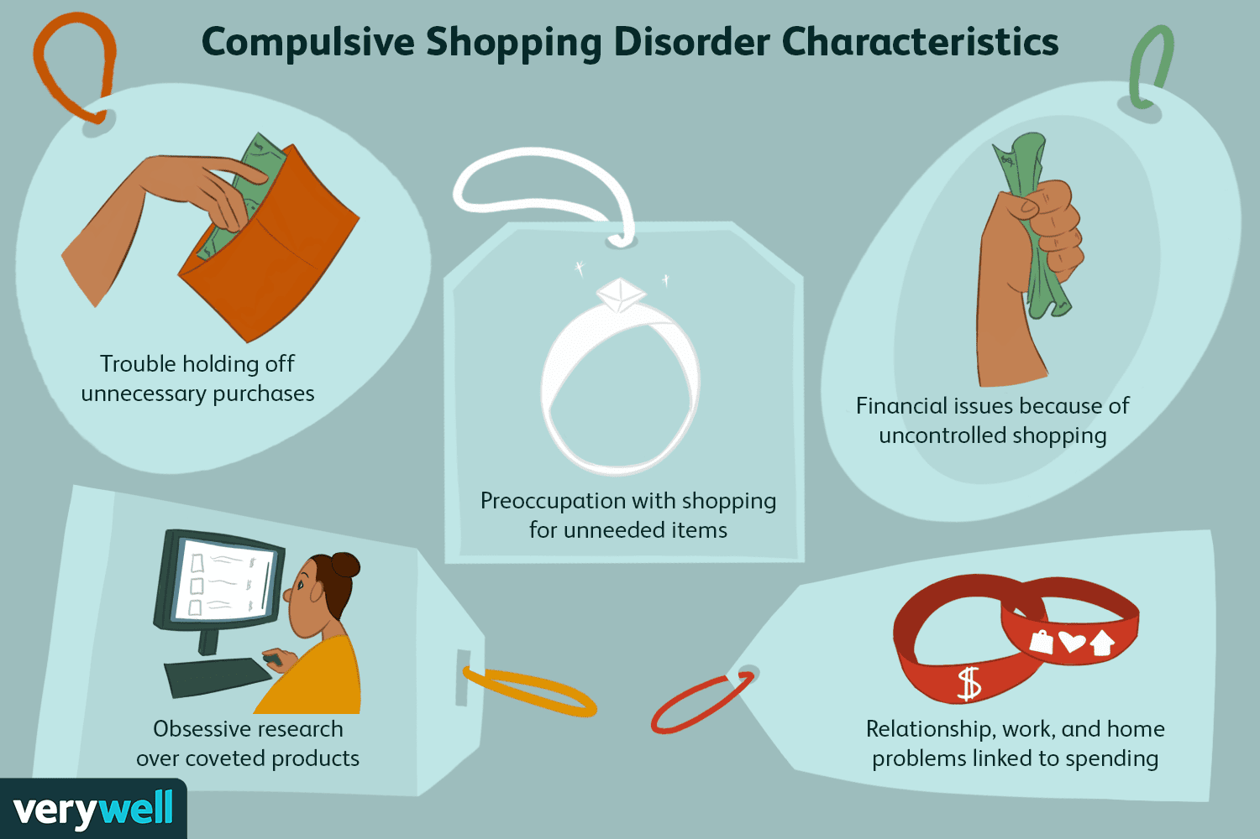
Compulsive Buying Behavior (CBB)
People with CBB may shop more than they can afford or need, and may have difficulty controlling their shopping. They may also experience pre-purchase anxiety or tension, and feel a sense of relief after making a purchase. Recent researchers indicates that compulsive buying behavior affects almost 5% of adult population in developed countries – particularly women in low income groups.
Material Self

Slide 20
Material/Economic Self
Personality is defined as a sum of total of outer physiological as well as the inner psychological characteristics that determine and reflect how a person reacts to his environment.
The term personality has been defined varied, so has been the evolution, the concepts of nurture and nature are always in a debate. Some look personality as a unified whole, other focus on specific personality traits.
In other words, personality trait is a person inclination to behave in a particular way while interacting with external environment to achieve goals. Meanwhile, a group of personality who share personality traits falls into a personality class.
Material Self

Slide 21
Consumer Personality
Consumer Personality is defined as the characteristics that determine and reflect how consumer make choices with regard to buying patterns and consumption behavior. Consumer purchase patterns are always influenced by their personality traits. Just as all consumers, have different personality make ups, the decision choices with regard to purchase of products and brand also differ especially when those product and brand match their personality traits. By that, personality traits could be general as well as consumption will be specific. This unique dynamic organization of characteristics of a particular person, physical and psychological influence behavior and responses to the social and physical cues.
Material Self

Slide 22
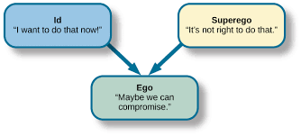
The Freudian Theory and Consumption
The Freudian theory holds relevance for studying consumer behavior. The consumer reaction with respect to purchase decisions and post purchase behavior are a reflection of individual personality. The three elements namely; Id, Ego and Superego can used as explanation of consumer behavior.
Material Self

